Slide 1

Analysis of London Airbnb Data

Slide 2
Data source
http://insideairbnb.com/
Analysis of London Airbnb Data

Slide 3
Data processing
Study the file
Neighourhood
Room type
Price
Minimum nights
Number of reviews
Last reviews
Analysis of London Airbnb Data

Slide 4
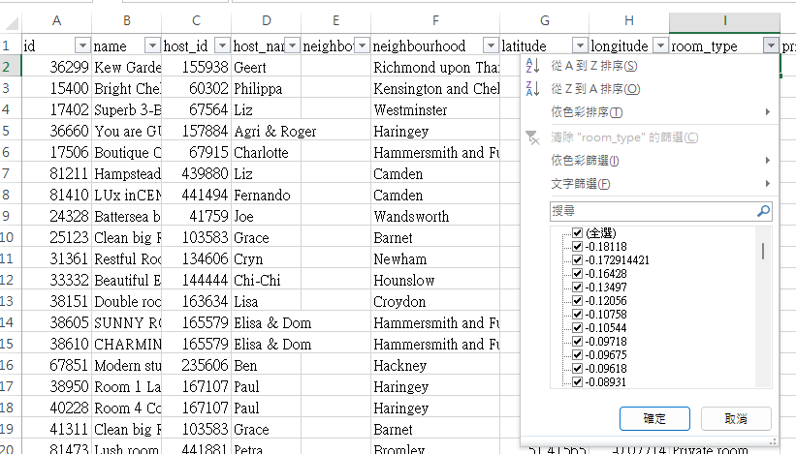
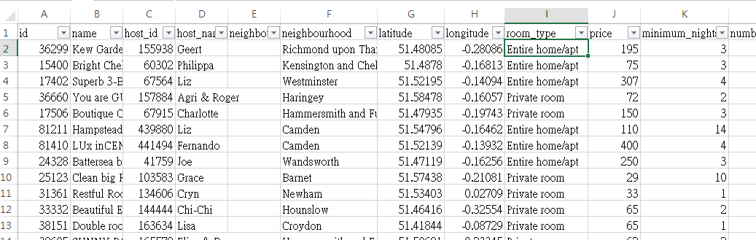
Data processing
Put the data to correct field
Remove data which may be difficult to be cleaned
Add news columns and create grouping (number of review, number of minimum nights, Inner/ Outer London) to the data
Only use data with last review in 2021 and 2022, and price larger than 0
Analysis of London Airbnb Data

Slide 5
Finding
Rental will be lower if minimum nights is larger.
Rental in Inner London is larger than Outer London
Rental is lower for owner with more review (Note: the relation may be caused by other factor, say number of review is correlated to whether the property was placed in Airbnb recently or long time ago (which may related to when the property was bought), such that the rental would be higher for property which is bought more recently.)
Analysis of London Airbnb Data

